Slide 1

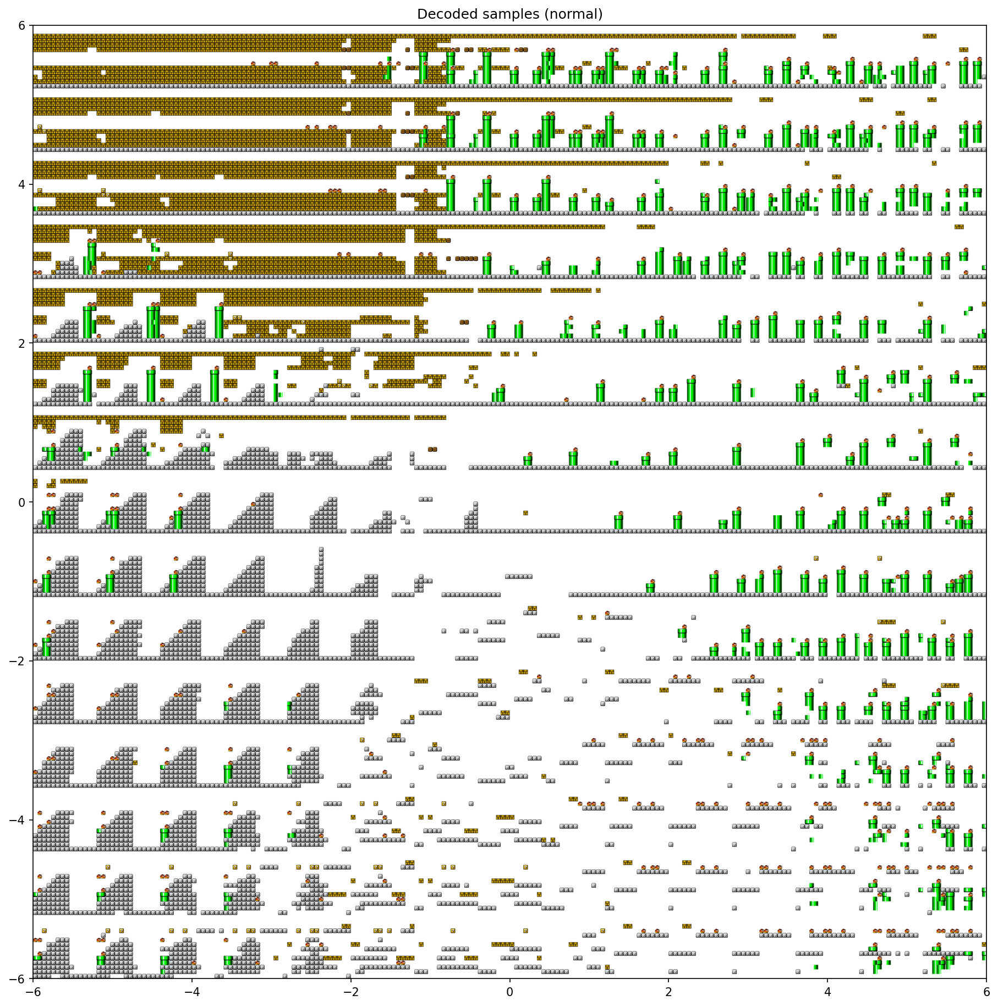
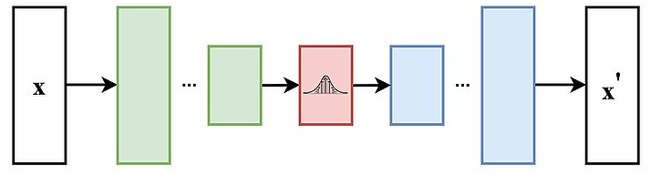
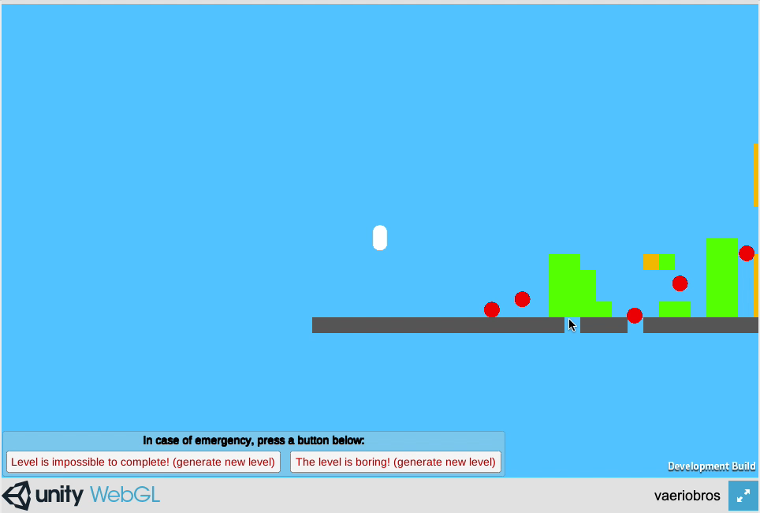
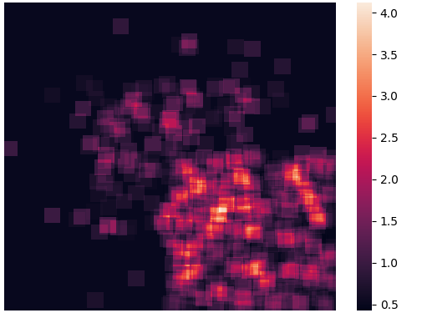
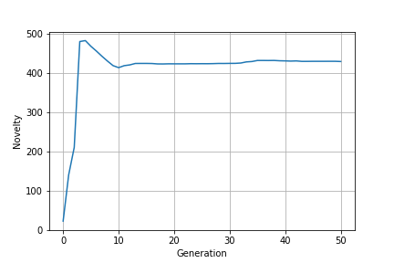


Super VAE-rio Bros is a Experience Driven PCG framework for generating Super Mario levels whilst observing player preferences for quality and novelty.
Level Slice Generator
Mario Web App
Level Evaluator and Provider
Player Actions to Preferences Model
Playthrough Simulator

Slide 2
Mario Web App

Slide 3
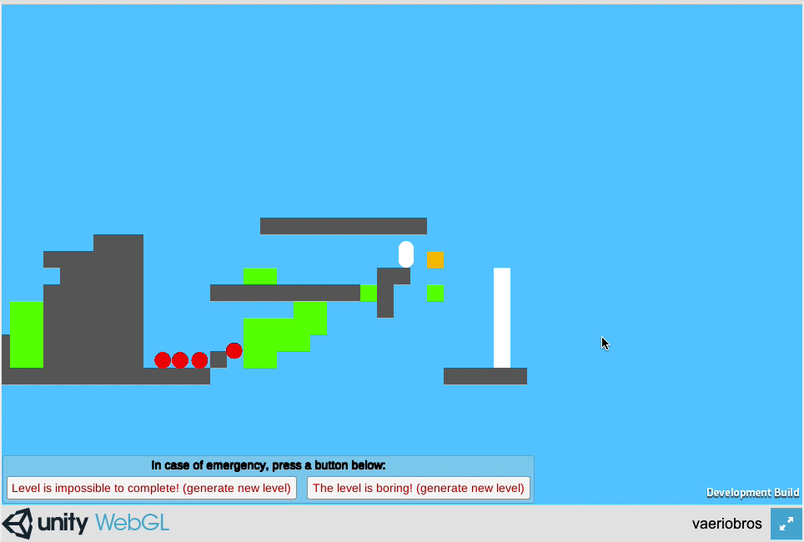
Mario Web App

Slide 4
Super VAE-rio Bros is a Experience Driven PCG framework for generating Super Mario levels whilst observing player preferences for quality and novelty.
Level Slice Generator
Mario Web App
Level Evaluator and Provider
Player Actions to Preferences Model
Playthrough Simulator

Slide 5
Level Evaluator and Provider
Player Actions to Preferences Model

Slide 6
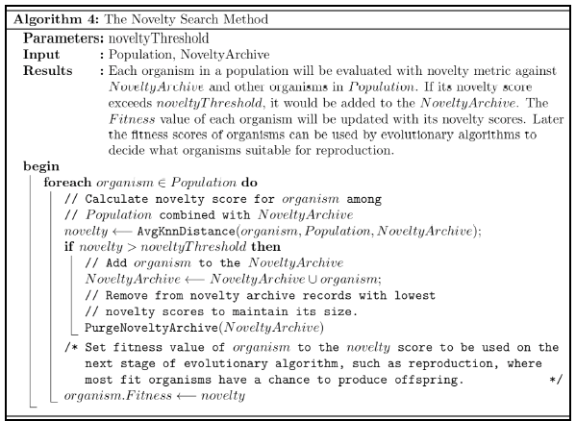
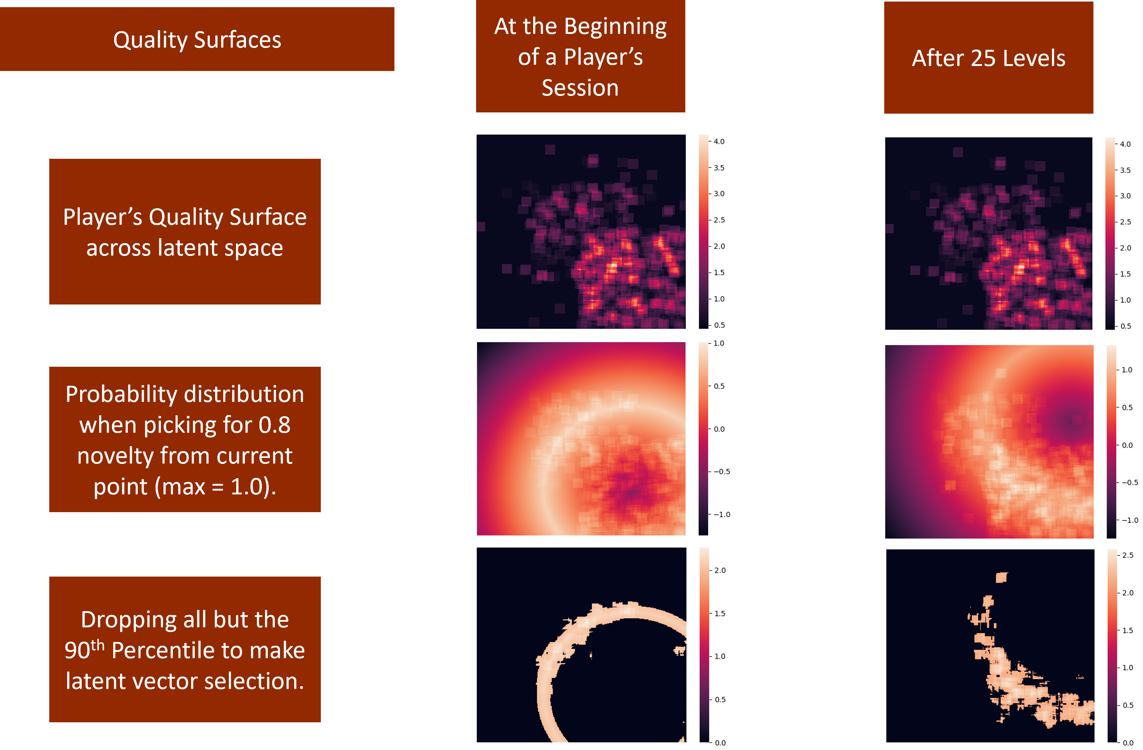
Level Evaluator and Provider

Slide 7
Super VAE-rio Bros is a Experience Driven PCG framework for generating Super Mario levels whilst observing player preferences for quality and novelty.
Level Slice Generator
Mario Web App
Level Evaluator and Provider
Player Actions to Preferences Model
Playthrough Simulator

Slide 8
Level Slice Generator

Slide 9
Super VAE-rio Bros is a Experience Driven PCG framework for generating Super Mario levels whilst observing player preferences for quality and novelty.
Level Slice Generator
Mario Web App
Level Evaluator and Provider
Player Actions to Preferences Model
Playthrough Simulator

Slide 10
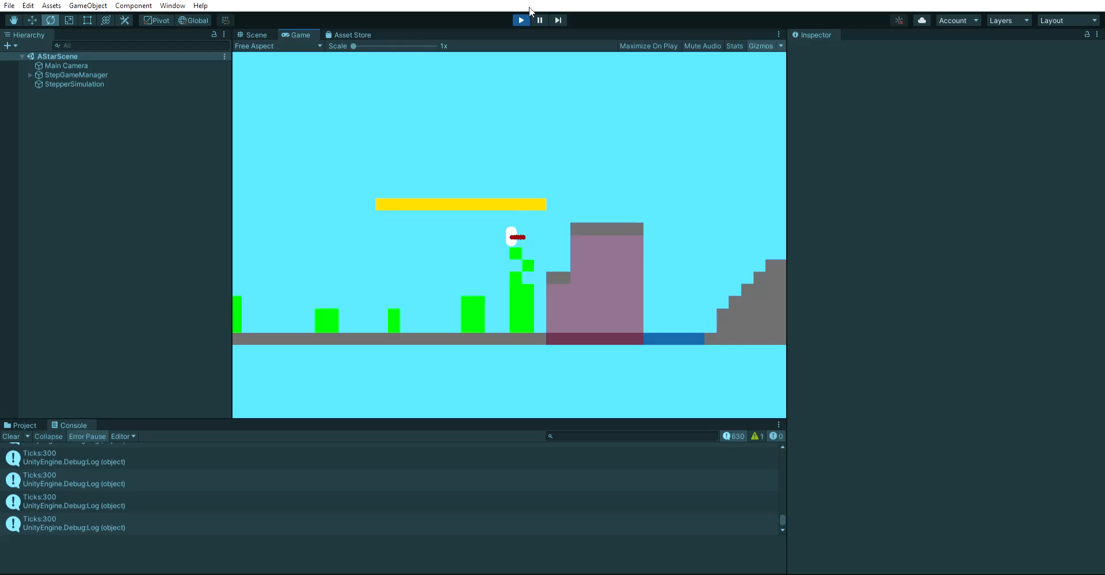
Playthrough Simulator
Playthrough Simulator

Slide 11
Playthrough Simulator
Playthrough Simulator

Slide 12
Super VAE-rio Bros is a Experience Driven PCG framework for generating Super Mario levels whilst observing player preferences for quality and novelty.
Level Slice Generator
Mario Web App
Level Evaluator and Provider
Player Actions to Preferences Model
Playthrough Simulator

